Slide 1

JS for Front-End
Introduction to Bootstrap
SoftUni Team
Technical Trainers
Software University
http://softuni.bg

Slide 2
Table of Content
Introduction to Bootstrap
How to import Bootstrap?
Grid System
Theming Bootstrap
Components
Plugins

Slide 3
Have a Question?
sli.do
#JS-CORE

Slide 4
Introduction to Bootstrap
Build Responsive, Mobile-first Projects

Slide 5
Bootstrap
World's most popular front-end component library
Open source toolkit for developing with HTML, CSS, and JS
Works with:
Responsive grid system
Extensive prebuilt components
Powerful plugins built on jQuery

Slide 6
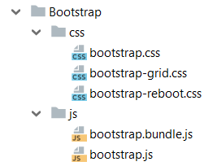
How To Import Bootstrap
Include from a BootstrapCDN
Download Resources
<link rel="stylesheet" href="../bootstrap/css/bootstrap.min.css"/>
<script src="../jquery/jquery.3.2.1.min.js">
</script>
<script src="../bootstrap/js/bootstrap.min.js"> </script>

Slide 7

Bootstrap Grid System
Build Layouts with Grid

Slide 8
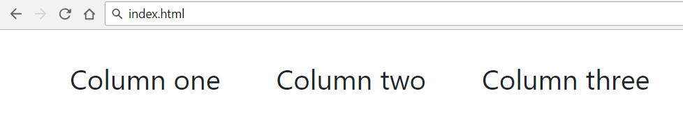
Bootstrap Grid System - Demo
index.html
Container
. . .
<div class="container">
<div class="row">
<div class="col-xs m-3">Column one</div>
<div class="col-xs m-3">Column two</div>
<div class="col-xs m-3">Column three</div>
</div>
</div>
…
Row
Columns

Slide 9
Bootstrap Containers
Rows must be placed in containers
.container has one fixed width for each screen size
(xs, sm, md, lg)
.container-fluid expands to fill the available width

Slide 10

Theming Bootstrap
Enable the Built-in Theme to Add Components

Slide 11
Bootswatch
Bootswatch is a collection of open source themes for Bootstrap
Usage
Download the bootstrap.min.css file
Replace Bootstrap's default stylesheet
Still include Bootstrap's JavaScript file to have functional dropdowns, modals, etc.

Slide 12

Bootstrap Components
Over a Dozen Reusable Components

Slide 13
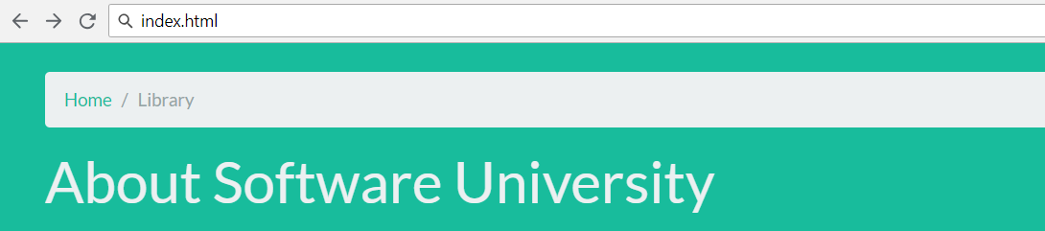
Page Header and Breadcrumbs
Indicate the current page's location within a navigational hierarchy
<body class="bg-success">
<div class="container m-4">
<div class="page-header">
<ol class="breadcrumb">
<li class="breadcrumb-item"><a href="#">Home</a></li>
<li class="breadcrumb-item active">Library</li>
</ol>
<h1 class="h1 text-light">About Software University</h1>
</div>
</div>
</body>

Slide 14
Button Groups
Custom button styles with support for multiple sizes, states, and more
index.html
<button type="button" class="btn btn-primary">Primary</button>
<button type="button" class="btn btn-secondary">Secondary</button>
<button type="button" class="btn btn-success">Success</button>
<button type="button" class="btn btn-danger">Danger</button>
Documentation: https://getbootstrap.com/docs/4.1/components/buttons/

Slide 15
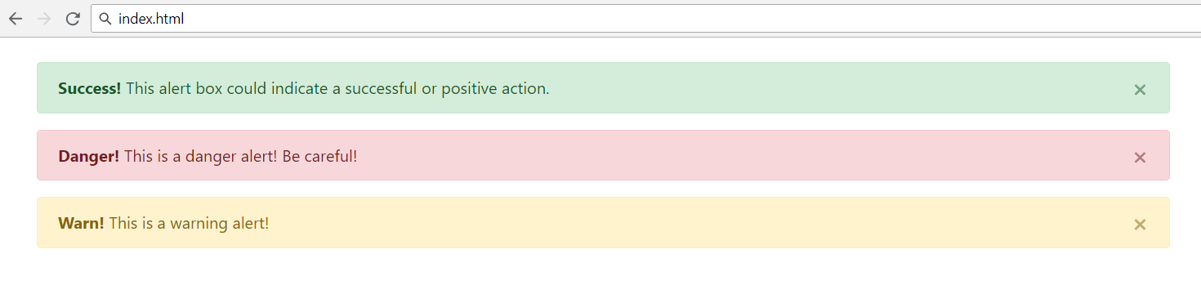
Alerts
Provide contextual feedback messages for typical user actions with the handful of flexible alert messages
<div class="alert alert-success alert-dismissable">
<a class="close" data-dismiss="alert" aria-label="close">×</a>
<strong>Success!</strong> This alert box could indicate a successful or positive action.
</div>
…

Slide 16
Navigation
Require a wrapping .navbar
Responsive by default
Come with built-in support for a handful of sub-components
.navbar-brand for your company, product, or project name
.navbar-nav for a full-height and lightweight navigation
.nav-item for every item in navigation
See more at: https://getbootstrap.com/docs/4.1/components/navbar/

Slide 17
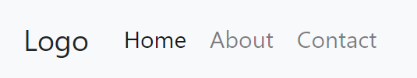
Navigation
<nav class="navbar navbar-expand-lg navbar-light bg-light">
<div class="collapse navbar-collapse">
<a class="navbar-brand">Logo</a>
<ul class="navbar-nav mr-auto">
<li class="nav-item">
<a class="nav-link" href="#">Home</a>
</li>
<li class="nav-item">
<a class="nav-link" href="#">About</a>
</li>
<li class="nav-item">
<a class="nav-link" href="#">Contact</a>
</li>
</ul>
</div>
</nav>

Slide 18
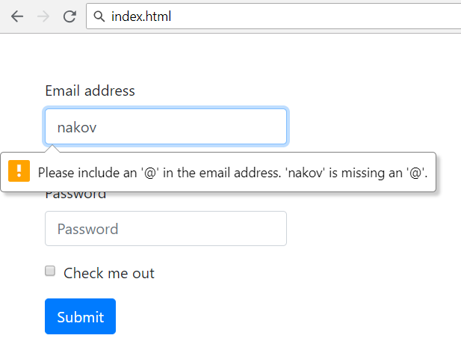
Forms
Control styles, layout options and custom components
Use type attribute on all inputs to take advantage of newer input controls
Email verification
Number selection

Slide 19
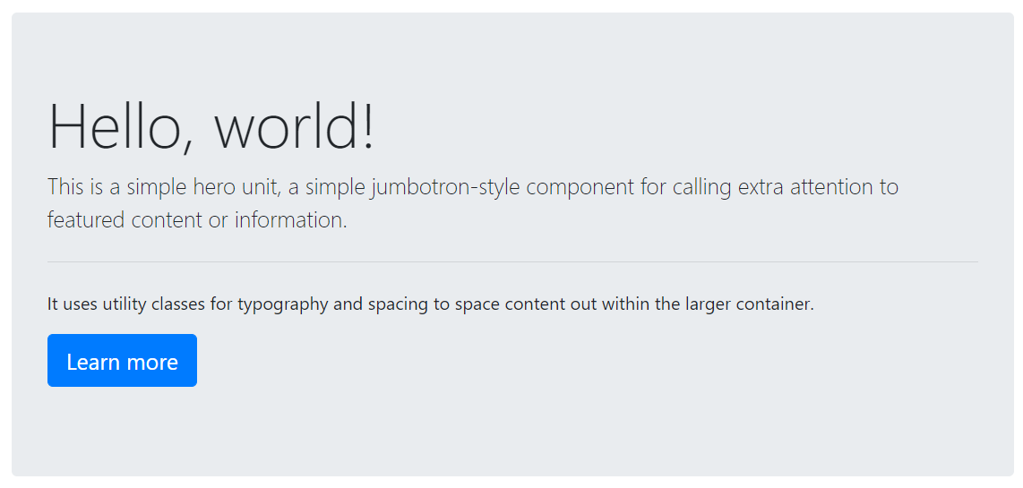
Jumbotron
Lightweight, flexible component for showcasing hero unit style content
<div class="jumbotron">
<h1 class="display-4">Hello, world!</h1>
<p class="lead">This is a ...</p>
<hr class="my-4"><p>It uses ...</p>
<p class="lead">
<a class="btn btn-primary btn-lg">
Learn more</a>
</p>
</div>
See more at: https://getbootstrap.com/docs/4.0/components/jumbotron/

Slide 20

Bootstrap Plugins
Components for Extending Bootstrap

Slide 21
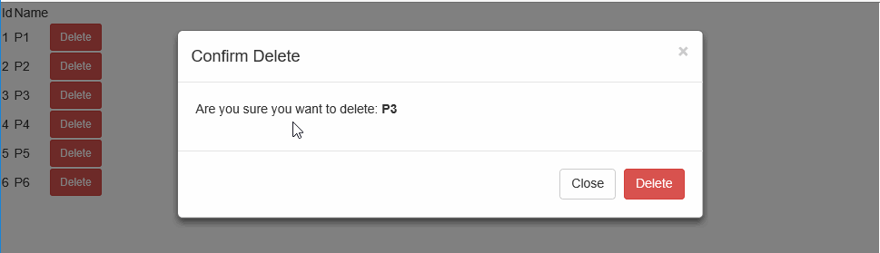
Modals
Dialog box/popup window that is displayed on top of the current page
Documentation: https://getbootstrap.com/docs/4.0/components/modal/

Slide 22
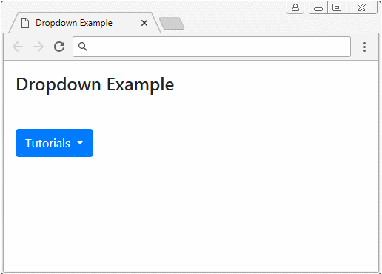
Dropdowns
Graphical control element, similar to a list box, that allows the user to choose one value from a list
Documentation: https://getbootstrap.com/docs/4.0/components/dropdowns/

Slide 23
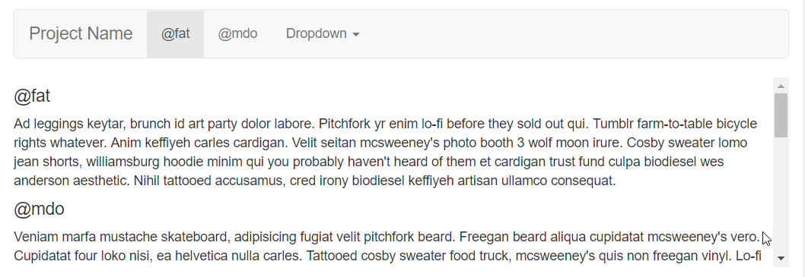
ScrollSpy
Automatically updating nav targets based on scroll position
Scroll the area below the navbar and watch the active class change
Documentation: https://getbootstrap.com/docs/4.0/components/scrollspy/

Slide 24
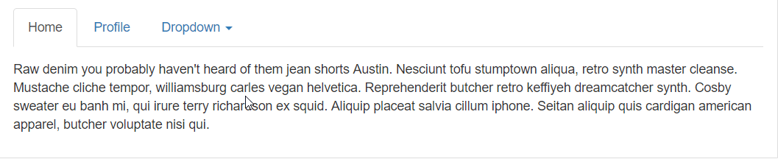
Togglable Tabs
Dynamic tab functionality to transition through tabs

Slide 25
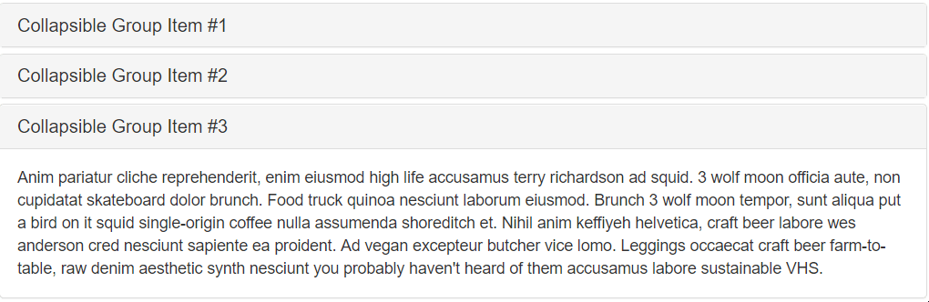
Collapse
Utilizes a handful of classes for easy toggle behavior
Documentation: https://getbootstrap.com/docs/4.0/components/collapse/

Slide 26

Carousel
Slideshow component for cycling through elements
Documentation: https://getbootstrap.com/docs/4.0/components/carousel/

Slide 27

Summary
…
…
…
Bootstrap - the most popular HTML, CSS and JS front-end framework
Responsive, mobile-first, prevailing
Easy to use and to learn it
Free and open source
Simple Integration
12-column responsive grid
Cheatsheet to Bootstrap components

Slide 28
https://softuni.bg/courses/js-apps

Slide 29













SoftUni Diamond Partners

Slide 30




SoftUni Organizational Partners

Slide 31




Trainings @ Software University (SoftUni)
Software University - High-Quality Education and Employment Opportunities
softuni.bg
Software University Foundation
http://softuni.foundation/
Software University @ Facebook
facebook.com/SoftwareUniversity
Software University Forums
forum.softuni.bg

Slide 32

License
This course (slides, examples, demos, videos, homework, etc.) is licensed under the "Creative Commons Attribution-NonCommercial-ShareAlike 4.0 International" license

